Slide 1
Development of an automated ETL Process

Slide 2
Table of contents
Introduction to Coria
Theory: Autonomous Systems
Theory: ETL Process
Data Analysis
Development of an Automated ELT Process
Live Demo
Evaluation and Outlook

Slide 3


Motivation
Internet presents one of the most important networks for today‘s world
Major financial and economical implications
Serious consequences for businesses and economies in case of non-functioning
Possible threats: nature, attacks, etc.

Slide 4
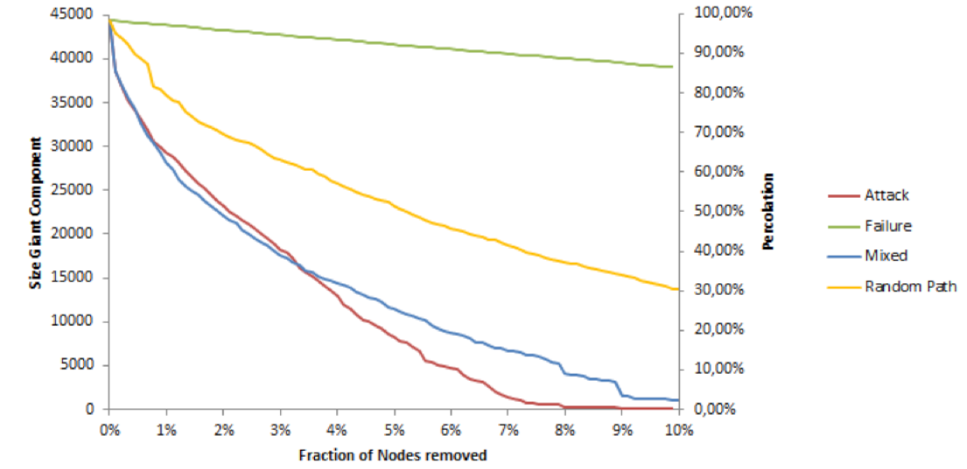
Motivation
Size of giant component refers to single largest component in the whole network
Elimination of 8% of nodes in the network: giant component equals zero
⇒ targeted attacks can cause wide damage
⇒ Coria helps to analyze connectivity risks

Slide 5
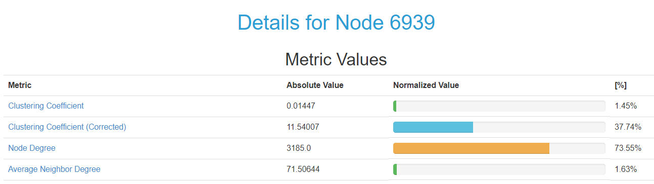
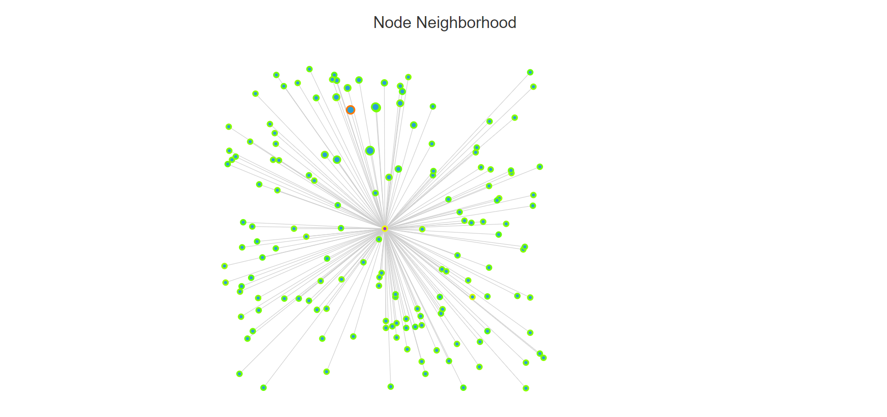
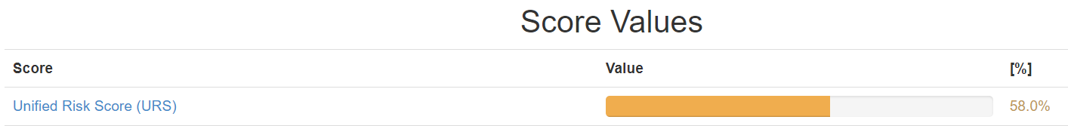
Objective of Coria
Analyzes connectivity risks for networks or organizations
Distinguishes multiple metrics like Node Degree, etc.
Calculates aggregated risk value
Based on network graphs
Offers different levels of granularity

Slide 6
Theory: Autonomous Systems
Autonomous Systems (AS) represents one level of internet topology
A set of routers under a single administration
⇒ Fokussing on connectivity risks on AS-level
ISP
AS
AS
R
R
R
R
IP
IP
IP
IP
IP
IP
IP
IP
IP
IP
IP
IP

Slide 7
Theory: Autonomous Systems
Autonomous Systems (AS) represents one level of internet topology
A set of routers under a single administration
⇒ Fokussing on connectivity risks on AS-level
Relationships of Ases:
Provider to Customer
Peer to Peer
ISP
provider
provider
customer
customer
AS
peer
peer
AS
R
R
R
R
IP
IP
IP
IP
IP
IP
IP
IP
IP
IP
IP
IP

Slide 8
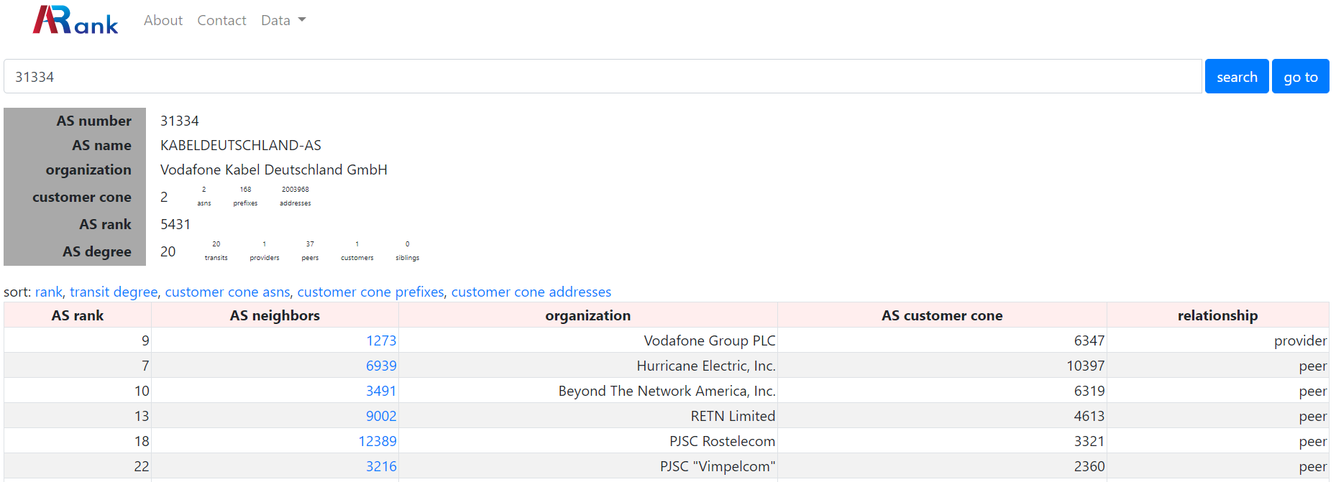
Example of an AS: Kabel Deutschland

Slide 9



Theory: ETL Process
Extraction: from data source(s), varying data formats
Transform: convert different data into proper format, that is storable
Load: load into target database
Data Sources
Data Warehouse
Clients
Extract
Transform
Load

Slide 10
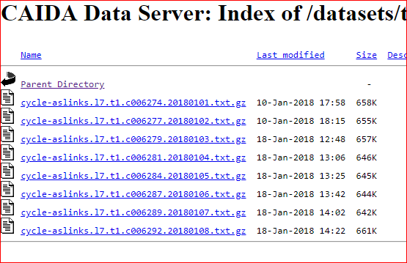
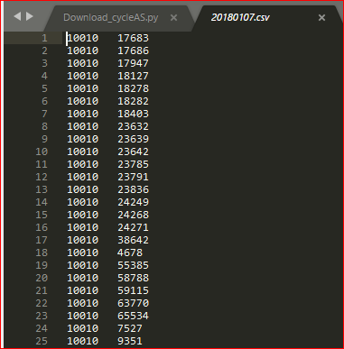
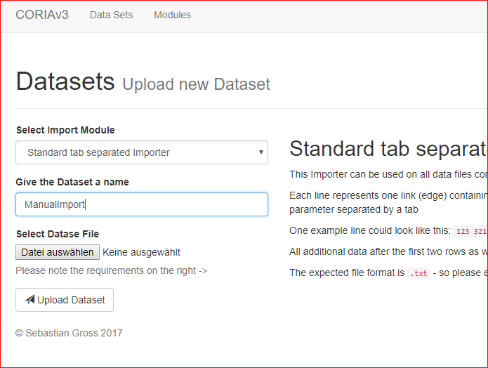
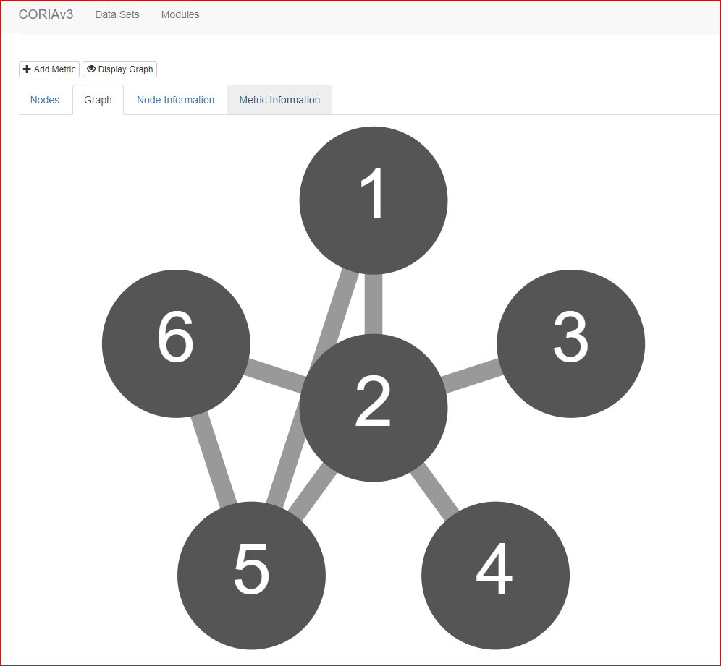
Coria ETL Process
Data Sources
Coria Data Warehouse
Clients
CAIDA
Extract
Transform
Load
ORVP
RIPE RIS
Extract
Transform
Load

Slide 11

Data Analysis

Slide 12
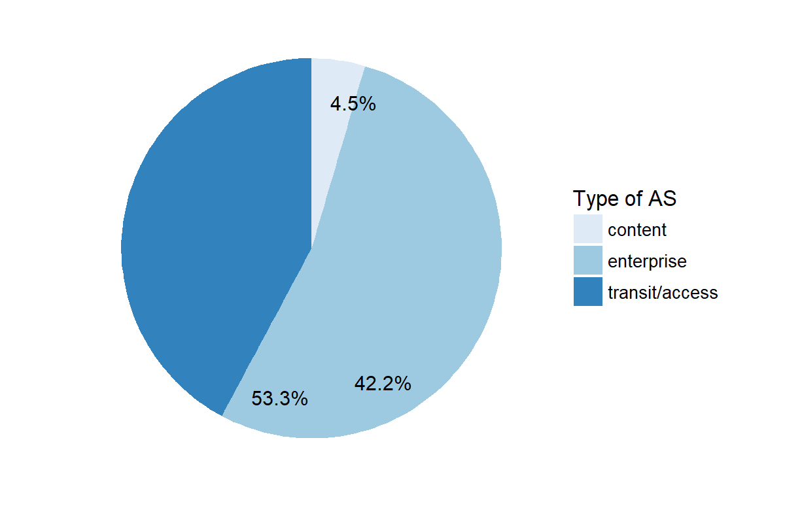
Data Analysis: AS Classification
ASes are classified according to their business type
Transit/Access: provide internet access or function as a transit
Content: provide content hosting and distribution systems
Enterprise: organizations, universities, companies that are mostly users
42.2%

Slide 13
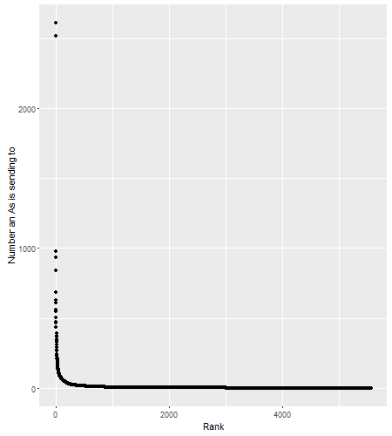
Data Analysis: AS Links
Distribution: sending AS nodes
Very frew Ases send to a large number of other Ases
Majority of ASes sends only to very small number of other Ases
⇒ high vulnerability for attacks

Slide 14
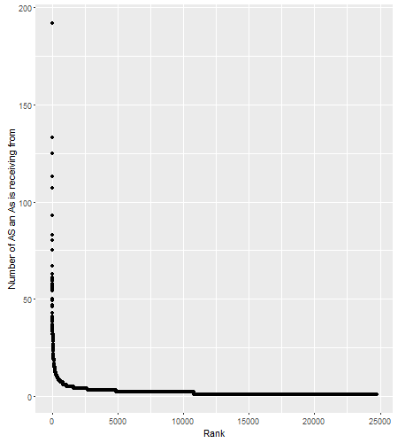
Data Analysis: AS Links
Distribution: receiving AS nodes
Very frew Ases receive from a large number of other Ases
Majority of ASes receives traffic only from a very small number of other Ases
⇒ high vulnerability for attacks

Slide 15
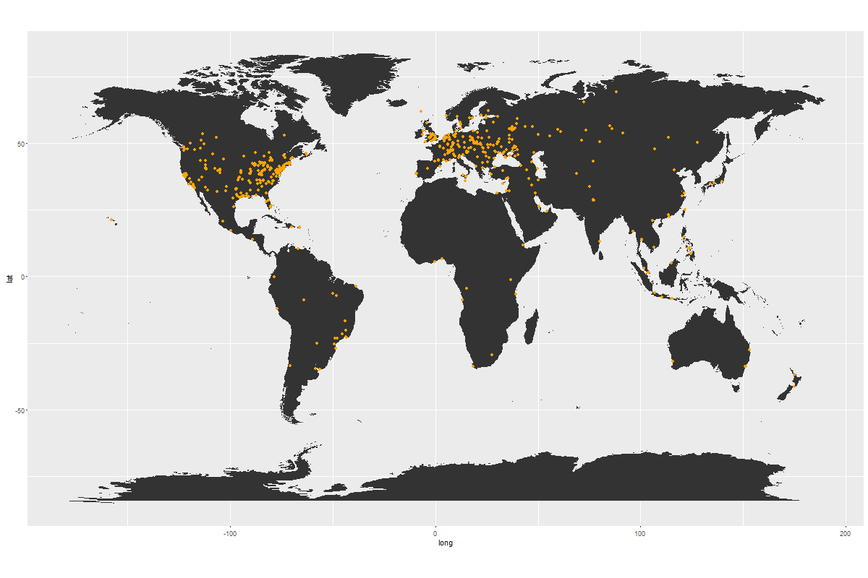
Data Analysis: AS Geographics
High concentration of ASes in North America and Europe
Less dense concentration in less developed countries
Remark: Difficult collection of AS-data and gathering through inference

Slide 16
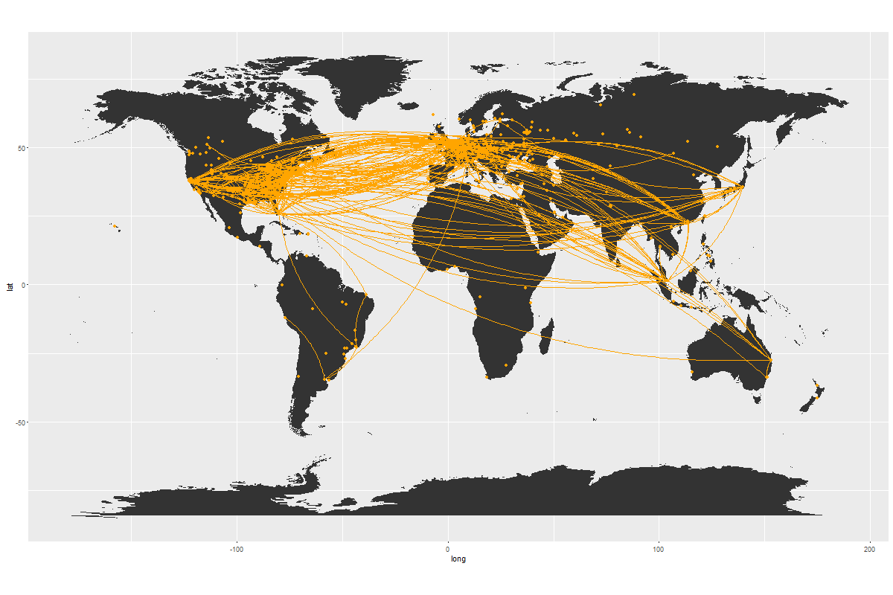
Data Analysis: AS Geographics
High concentration of ASes in North America and Europe
Less dense concentration in less developed countries
Remark: Difficult collection of AS-data and gathering through inference

Slide 17
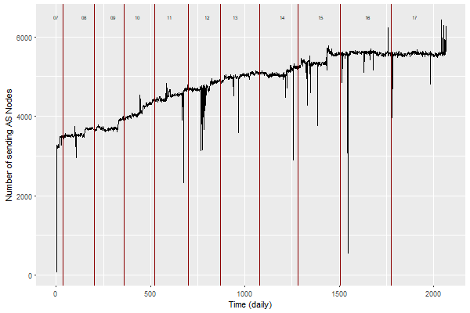
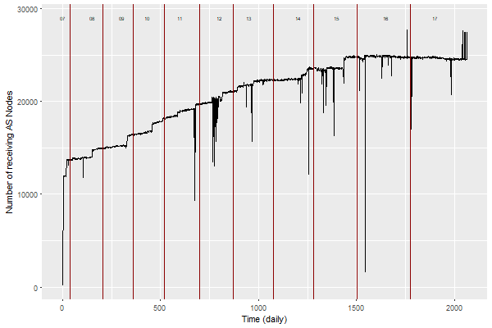
Data Analysis: Time Series Aspect
Development sending AS nodes
Development receiving AS nodes

Slide 18
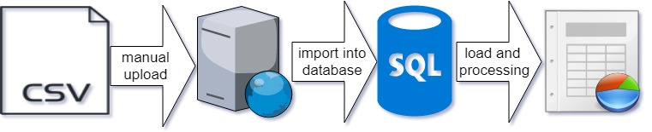
Automated ETL Process: Current State
There is no automated ETL Process
Extract
Transform
Load

Slide 19
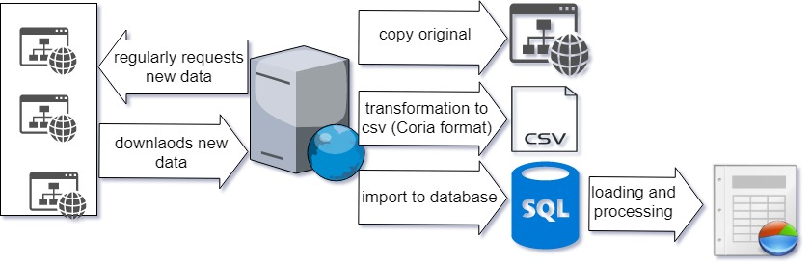
Automated ETL Process: Development and Integration
Our Contribution
CIADA
CoriaV3
Extract
Transform
Load

Slide 20
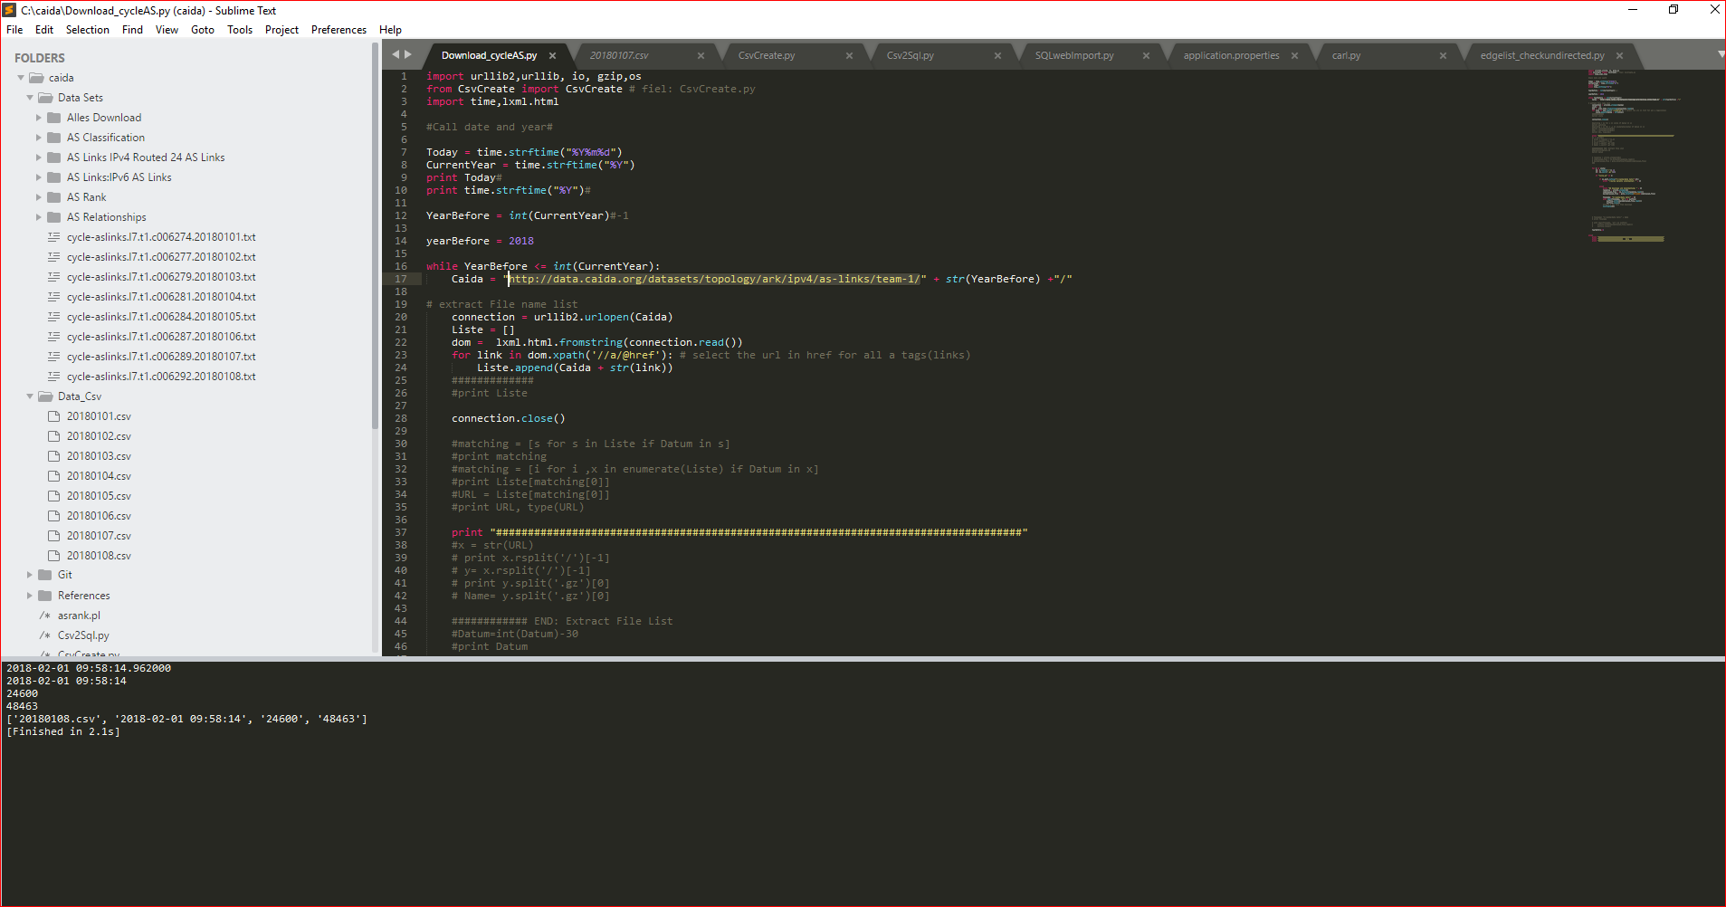
Automated ETL Process: Live Demo

Slide 21



Evaluation
Validation of latest data files
Copy of current data files
Transformion data to csv
Import data into the Coria MySQL database
Import scripts to the Coria framework (Python -> Java)
Data aggregation over time

Slide 22
Outlook
Apply automated ETL process to further data sources
Run Coria on a server (longtime evaluation)
Documentation

Slide 23
References
B. Fabian, G. Tilch, “Analyzing the Global-Scale Internet Graph at Different Topology Levels: Data Collection and Integration“.
D. Kiene-Maksimivic, E. Zinovyeva, J. Park, “CORIA 2.0: Augmenting a Universal Framework for Connectivity Risk Analysis”, 2017.
J. Dümig, “Modelling of an Extraction Transformation Loading (ETL) system for the connectivity risk analyzing framework CoRiA“, 2016.
M. Luckie et al., “AS Relationships, Customer Cones, and Validation”, Internet Measurement Conference, 2013.
M. Oehlers, B. Fabian, ”Graph Metrics for Internet Robustness: A Survey”, ACM Comput. Surv. 1, 1, Article 1, 2018.
S.Gross, “Development of a modular software framework for the analysis of network connectivity risks based on network graphs”, 2017.
T. Kober, “Business Intelligence in der Telekommunikation : Konzeption und Umsetzung einer Graphendatenbank mittels Neo4j“, 2016.

Slide 24
References
CAIDA UCSD, CAIDA AS Relationships Dataset, http://www.caida.org/data/as-relationships, Access on 28.01.18.
CAIDA UCSD, CAIDA AS Classification Dataset, http://www.caida.org/data/as-classification, Access on 28.01.18.
CAIDA UCSD, CAIDA AS IPV4 AS Links Dataset, http://www.caida.org/data/active/ipv4_routed_topology_aslinks_dataset.xml, Access on 28.01.18.
CAIDA UCSD, CAIDA AS Rank Dataset, http://as-rank.caida.org/, Access on 28.01.18.
CAIDA UCSD, CAIDA AS Relationship Geo Dataset, http://www.caida.org/data/as-relationships-geo/, Access on 28.01.18.

Slide 25
Thank you for your attention! Questions, Remarks, Feedback?

Slide 26
Appendix

Slide 27
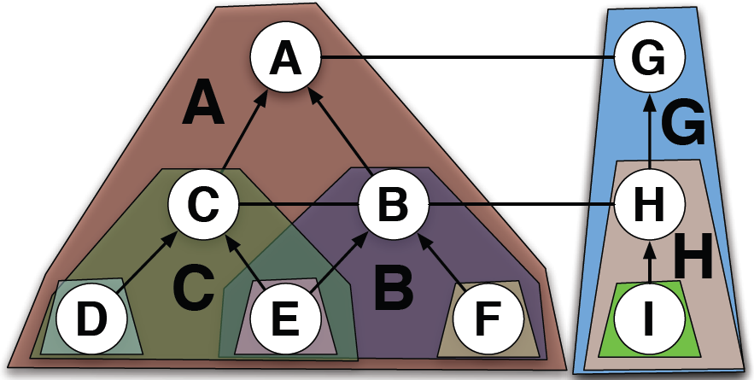
Appendix I: A Cusomer Cone
A’s customer cone: A, B, C, D, E, F
B’s customer cone: B, E, F
C’s customer cone: C, D, E
Source: https://www.caida.org/publications/presentations/2012/caida_asrank_wie/caida_asrank_wie.pptx
Notes:
Quelle: https://www.caida.org/publications/presentations/2012/caida_asrank_wie/caida_asrank_wie.pptx

Slide 28
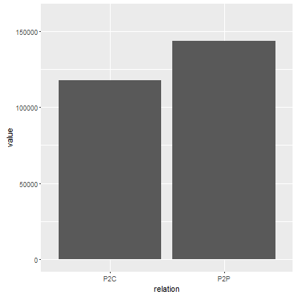
Appendix II: AS Relationships
Relationships have effects on network robustness, trafic engineering, etc.
AS topology is a consequence of business evolution and business decisions
P2C: Provider to Customer
P2P: Peer to Peer
Notes:
Graph is Pretty balanced: vertically as well as horizontally

